Slide 1
FORECASTING COVARIANCE MATRICES FOR ASSET ALLOCATION
ROBERT ENGLE AND
RICCARDO COLACITO

Slide 2

THE SETTING
This paper is part of the first
Econometric Institute/Princeton University Press lecture series
It will be presented at Erasmus University in Rotterdam 21,22,23 May
The topic is Dynamic Correlations

Slide 3
THE CLASSICAL PORTFOLIO PROBLEM
AT THE BEGINNING OF PERIOD T, CHOOSE PORTFOLIO WEIGHTS W TO MINIMIZE VARIANCE OVER T SUBJECT TO A REQUIRED EXPECTED RETURN.
AT THE END OF T, FORECAST THE DISTRIBUTION OF RETURNS FOR THE NEXT PERIOD AND ADJUST PORTFOLIO WEIGHTS

Slide 4
IMPLEMENTATION REQUIREMENTS
FORECAST OF EXPECTED RETURNS
FORECAST OF COVARIANCE MATRIX
OPTIMIZER, POSSIBLY WITH MANY CONSTRAINTS

Slide 5


MORE ADVANCED QUESTIONS
OPTIMIZATION OF A MULTI-STEP CRITERION
MAXIMIZE UTILITY RATHER THAN MINIMIZE VARIANCE
  Non-normal returns
  Non-MEAN-VARIANCE utility
  Intermediate Consumption
INCORPORATE PRIORS
CONSTRAIN SOLUTION
PAY TRANSACTION COSTS
MUST SOLVE MYOPIC MEAN-VARIANCE PROBLEM FIRST.

Slide 6
THE PROBLEM
CAN WE EVALUATE THE QUALITY OF COVARIANCE MATRIX FORECASTS WITHOUT KNOWING EXPECTED RETURNS?
I’ll PRESENT A SLIGHTLY NEW APPROACH TO AN OLD PROBLEM

Slide 7
SOME LITERATURE
Elton and Gruber(1973)
  Forecast period=5 years and 1 year.
  Accuracy measured by average absolute error of (realized correlation – forecast)
  Economic loss measured as return on efficient portfolio given future realized means and variances
Chan, Karceski, Lakonishok(1999)
  Three year horizon
  Minimum variance or minimum tracking error portfolio
  Economic value measured by efficient portfolio volatility
Fleming, Kirby, and Ostdiek(2001)
  One day horizon
  Expected returns are bootstrapped from full sample for dynamic performance
  Value of variance forecasts is measured by Sharpe Ratios
  Bootstrapped means, variances and covariances are used for static comparison.

Slide 8
MORE REFERENCES
Kandel, Shmuel, and Stambaugh, Robert F., 1996, On the Predictability of Stock Returns: An Asset Allocation Perspective, Journal of Finance, 51(2), 385-424.
Erb, Claude B., Harvey, Campbell R., and Viskanta, Tadas E., 1994, Forecasting International Equity Correlations, Financial Analysts Journal, 50, 32-45.
Cumby, Robert, Stephen Figlewski and Joel Hasbrouck, (1994) "International Asset Allocation with Time Varying Risk: An Analysis and Implementation", Japan and the World Economy, 6(1), 1-25
Ang, Andrew, and Bekaert, Geert, 1999, International Asset Allocation with Time-Varying Correlations, NBER Working Paper 7056.
Ang, Andrew, and Chen, Joe, 2001, Asymmetric Correlations of Equity Portfolios, forthcoming, Journal of Financial Economics.
Brandt, Michael W., 1999, Estimating Portfolio and Consumption Choice: A Conditional Euler Equations Approach, Journal of Finance, 54(5), 1609-1645.
Campbell, Rachel, Koedijk, Kees, and Kofman, Paul, 2000, Increased Correlation in Bear Markets: A Downside Risk Perspective, Working Paper, Faculty of Business Administration, Erasmus University Rotterdam.
AÄ³t-Sahalia, Yacine, and Brandt, Michael W., 2001, Variable Selection for Portfolio Choice, Journal of Finance, 56(4), 1297-1355.
Longin, Fran»cois, and Solnik, Bruno, 2001, Extreme Correlation of International Equity Markets, Journal of Finance, 56(2), 649-676.
Kraus, Alan, and Litzenberger, Robert H., 1976, Skewness Preference and the Valuation of Risk Assets, Journal of Finance, 31(4), 1085-1100.
Markowitz, H., 1952, Portfolio Selection, Journal of Finance, 7, 77-99.

Slide 9
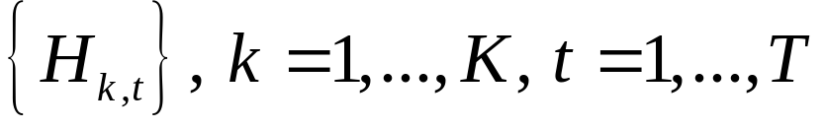
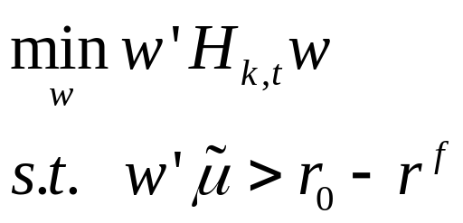
THE FORMULATION
For a set of K covariance matrix processes
Solve the portfolio problem with a riskless asset
Where r^{f} is the risk free rate, r₀ is the required return and µ with a tilde is a vector of excess expected returns

Slide 10
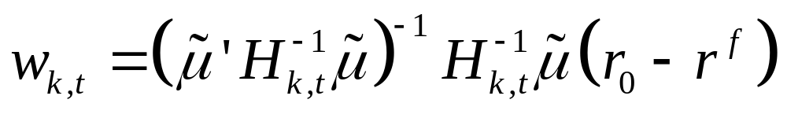
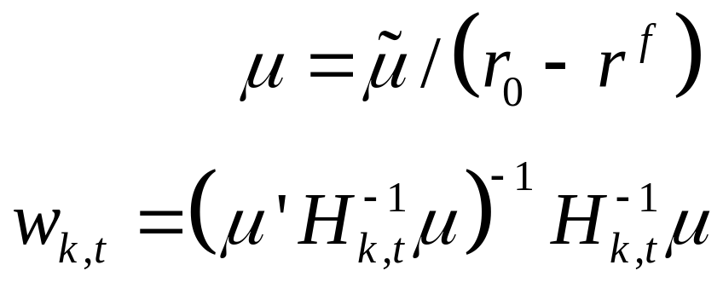
THE SOLUTION
The optimal trajectory of portfolio weights is:
This solution always exists for H positive definite and positive required excess return.
Letting

Slide 11
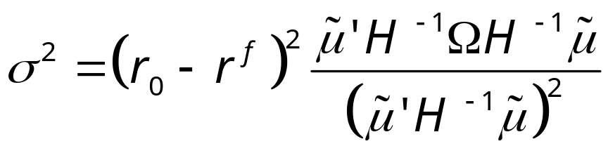
VALUATION OF VOLATILITY
The minimized variance is given by
Hence a 1% decrease in standard deviation is worth a 1% increase in required excess return.

Slide 12
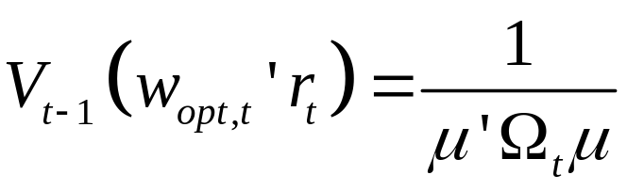
The True Process
Suppose the vector of returns, r_{t} has covariance matrix Ω_{t .}
Then the conditional variance of the optimized portfolio will be
If H_{k,t}= Ω_{t ,} then the variance will be

Slide 13
THEOREM
The conditional variance of every optimized portfolio will be greater than or equal to the conditional variance of the portfolio optimized on the true covariance matrix.
This will be true for any vector of expected returns and any required excess return.

Slide 14
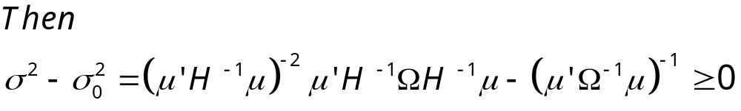
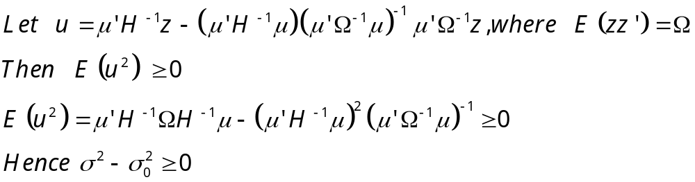
THEOREM
To Show:
Proof:

Slide 15
IMPLICATION
For a vector of expected returns, and a conditional covariance matrix, calculate the optimal weights and the subsequent portfolio return
Choose covariance matrices that achieve lowest portfolio variance for all relevant expected returns
Or choose conditional on state variables.
Minimum variance portfolio is obtained when µ=ι

Slide 16
PICTURES
Plot portfolio weights in two dimensions
Volatility is an elipse
Expected return is a line with slope given by ratio of expected returns.

Slide 17
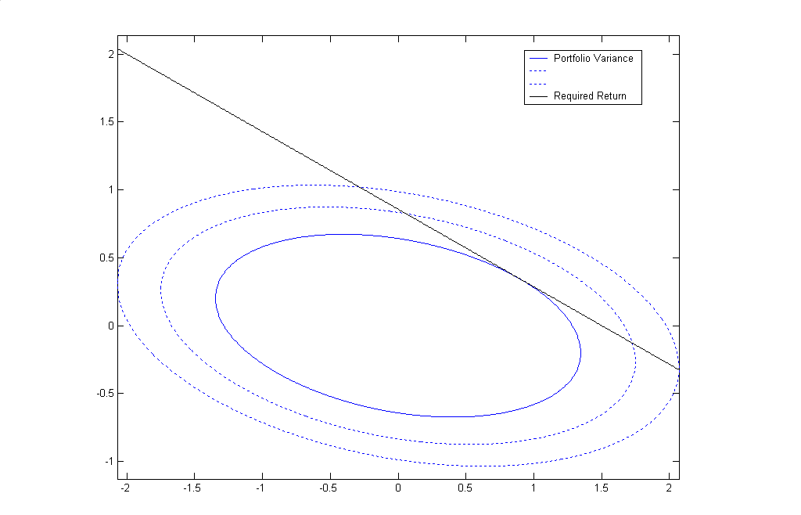

Slide 18
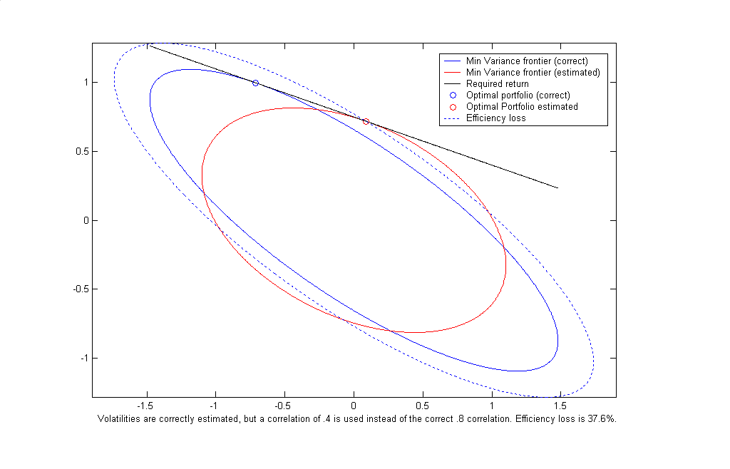

Slide 19
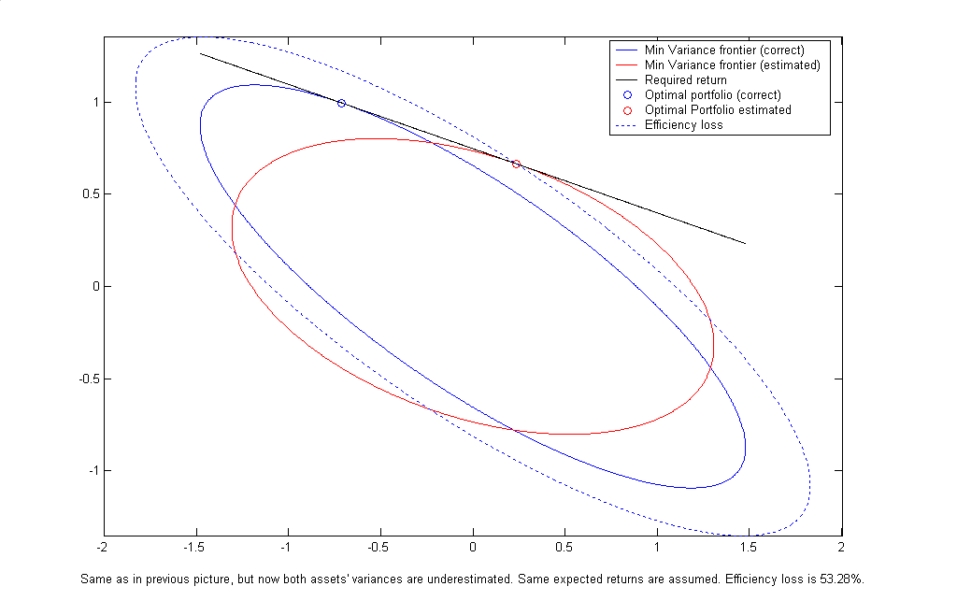

Slide 20
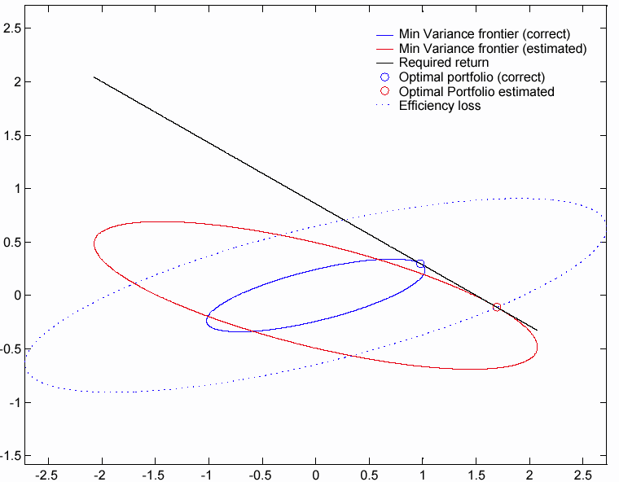
Variances are correctly estimated, but a correlation of .7 is used instead of a correlation of -.7. Efficiency loss is 610%.

Slide 21
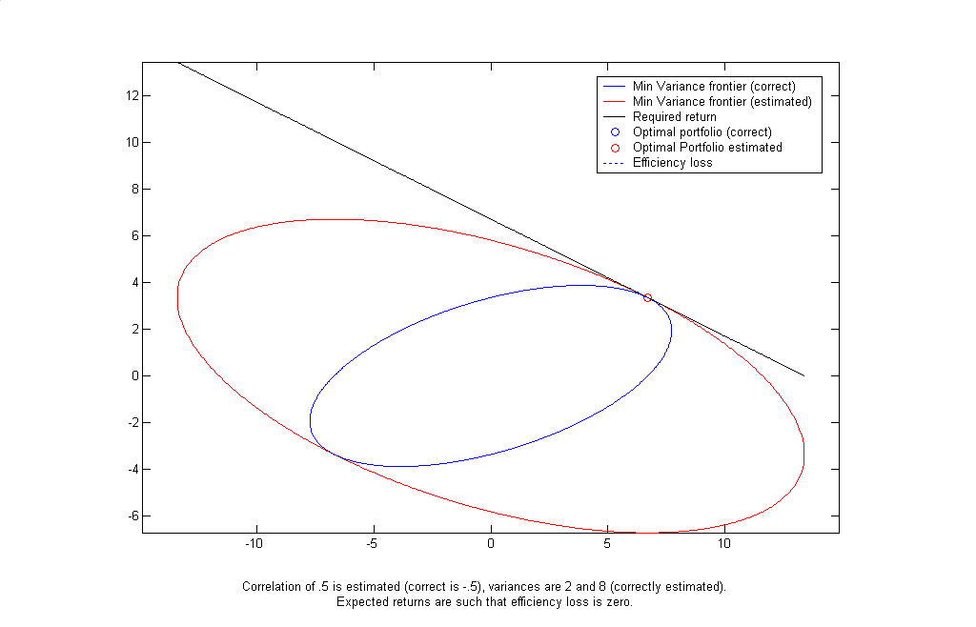

Slide 22
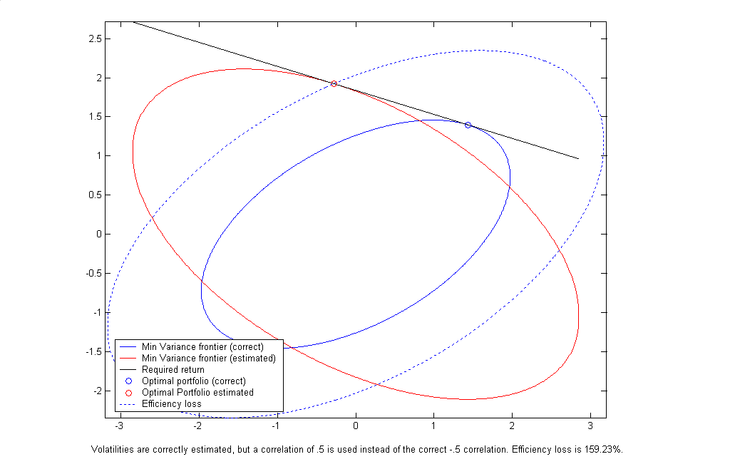

Slide 23
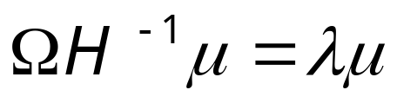
A COSTLESS ERROR
There is always an expected return vector that makes using the wrong covariance matrix costless.
For this return, both ellipses are tangent to the required return line at the same point.

Slide 24
TESTING
Testing that one method correctly assesses the risk
Testing that one method is significantly better than another

Slide 25
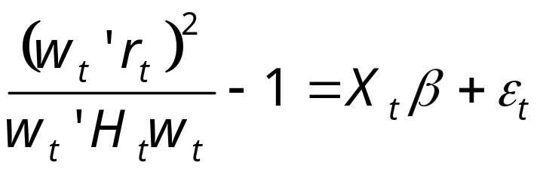
THE ACCURACY OF A METHOD
Let {r_{t}} be a vector of zero mean asset returns with conditional covariance matrices H_{t}.
For each µ, the optimal portfolio weights w_{t} are constructed and portfolio returns w_{t}’r_{t}.
TEST: H₀ : =0

Slide 26

CHOICE OF X
X includes
  Intercept
  Lagged dependent variable
  4 dummies for predictions that the variance is in upper 5%,10%, 90%,95% (that is, when the variance is predicted to be very low, is this unbiased?)

Slide 27
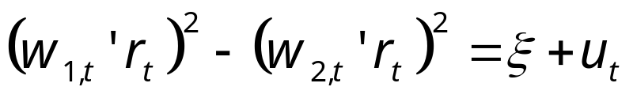
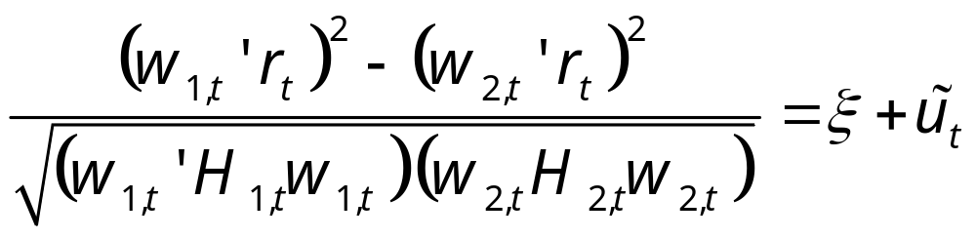
TESTING EQUALITY OF TWO MODELS
Using same expected returns but different covariances, test the hypothesis that there are no differences
Diebold – Mariano(1995) test =0 by least squares using HAC standard errors.
Weighted:

Slide 28
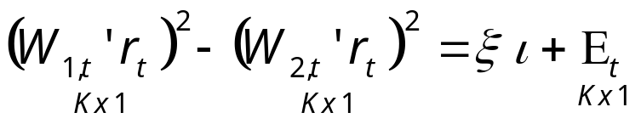
JOINTLY TESTING FOR MANY MEAN VECTORS
For expected return vectors
  µ^{k}, k=1,…,K, compute weights
  w^{k} for each time and estimator
  Stack these into W_{t}’r_{t} a vector of optimized portfolios
TEST: =0
GMM using vector HAC covariance
Or weight as on previous slide

Slide 29
THE DATA
Daily returns on S&P500
Daily returns on 10-year Treasury Note Futures
Both from DataStream from Jan 1 1990 to Dec 18 2002

Slide 30
SUMMARY STATISTICS
 | S&P 500 | 10 Yr Treas Fut.
Ann. Mean | 6.7% | 1.8%
Ann. Vol | 16.2% | 6.1%
Correlation |  | .062
Kurtosis | 5.13 | 6.93

Slide 31
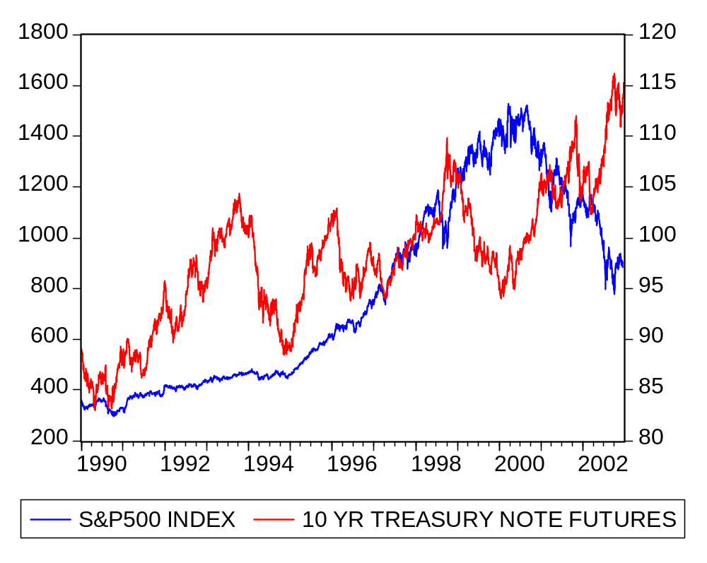

Slide 32
THE METHODS
BEKK style Multivariate GARCH
  Scalar
  Scalar with Variance Targeting
  Diagonal with Variance Targeting
Dynamic Conditional Correlation style Multivariate GARCH
  Integrated
  Mean Reverting
  Generalized
  Rank
  Asymmetric
  Generalized Asymmetric

Slide 33
METHODS CONTINUED
ORTHOGONAL GARCH (garch on principle components)
  Least squares Beta
  Garch Beta
MOVING AVERAGE
  20 days
  100 days
EXPONENTIAL WEIGHTED AVERAGE
  .06 as in RiskMetrics™
FIXED
  Full Sample
  1000 Days presample
  Daily updating

Slide 34
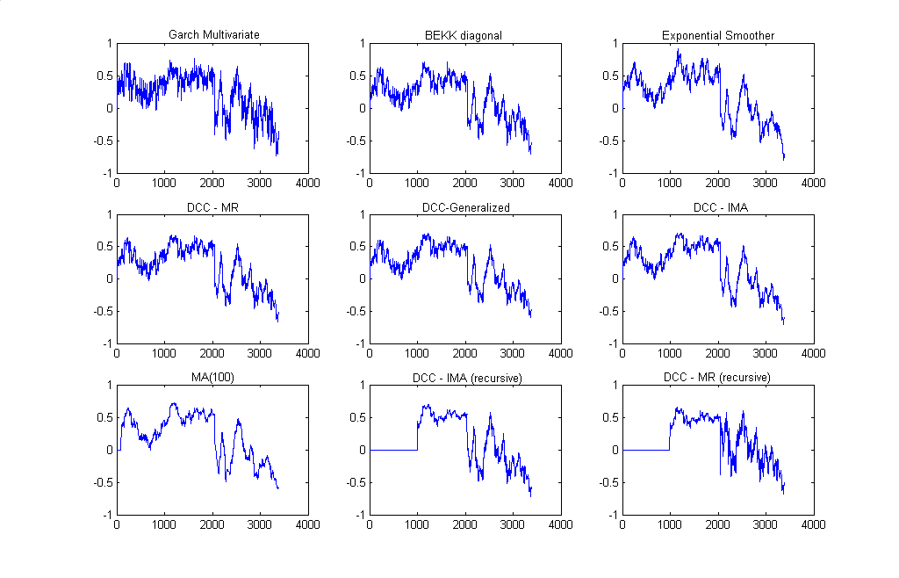

Slide 35
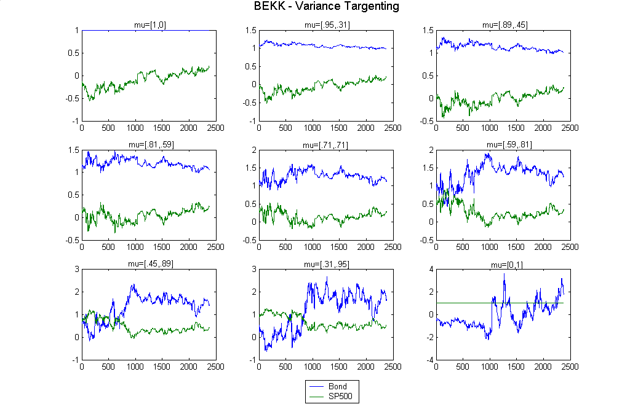

Slide 36
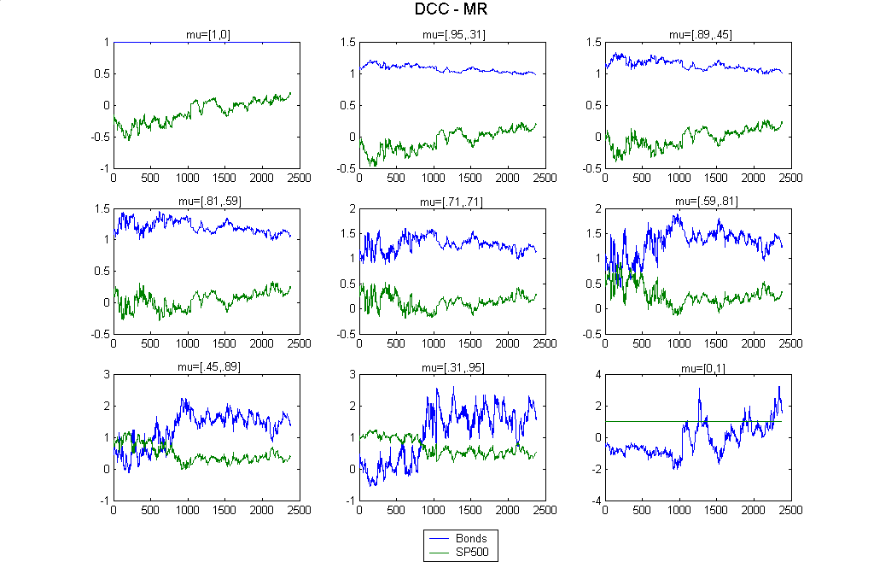

Slide 37
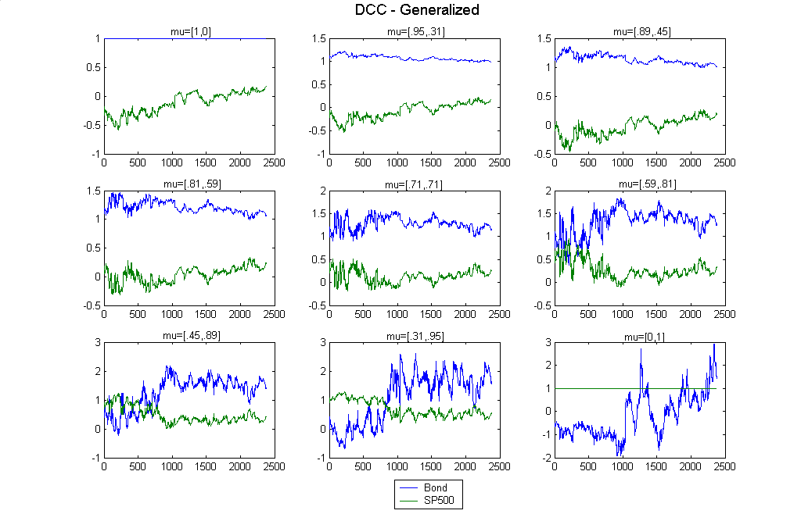

Slide 38
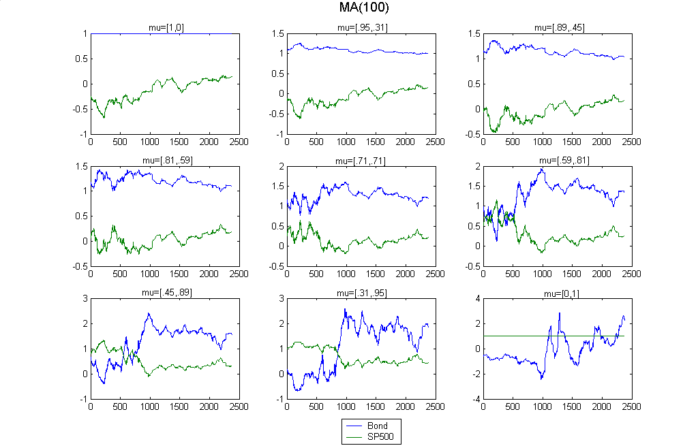

Slide 39
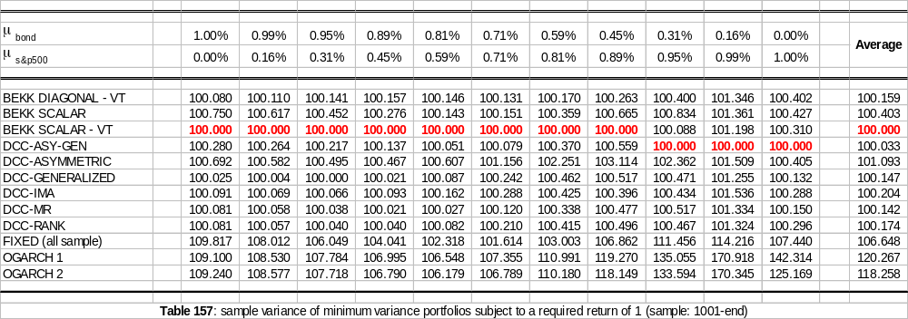

Slide 40
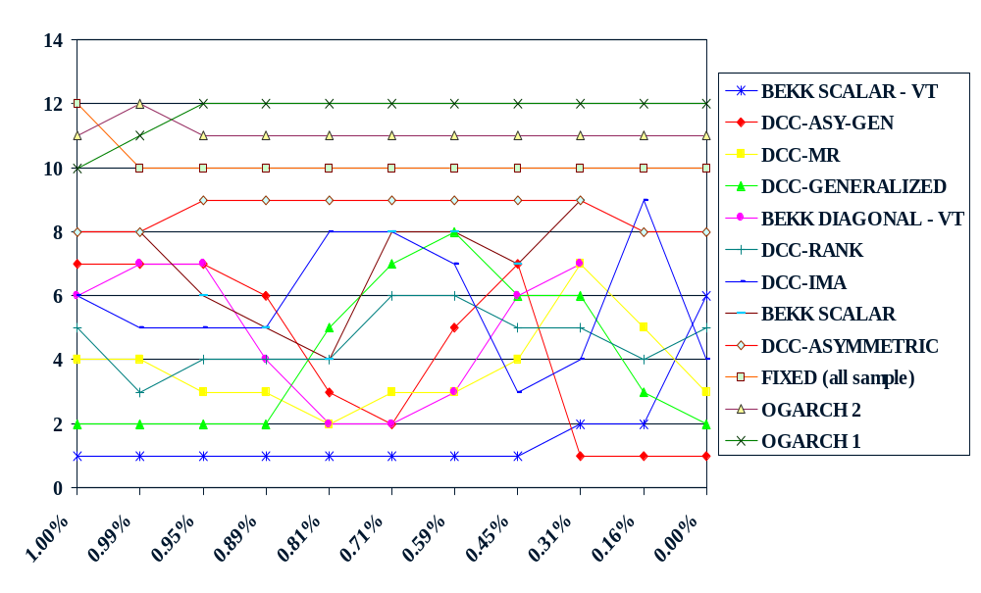
Variance Rank across Bond Expected Returns

Slide 41
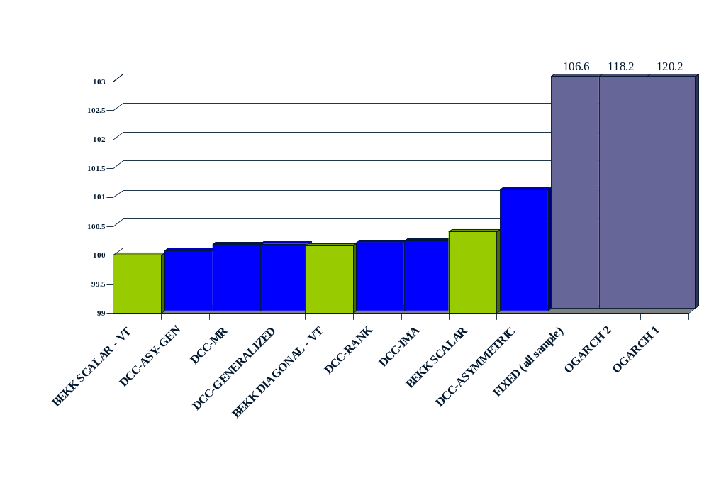
Comparision of volatilities (non recursive estimates)
Notes:
The recursive models including MA(100), DCC-IMA, DCC-ASY, EX-SMOOTH, DCC-MR, DCC-RANK all lie between BEKK SCALAR and DCC-ASY

Slide 42
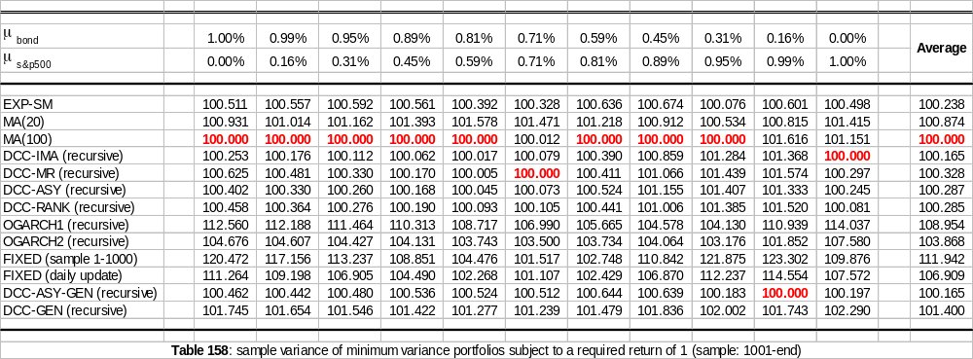

Slide 43
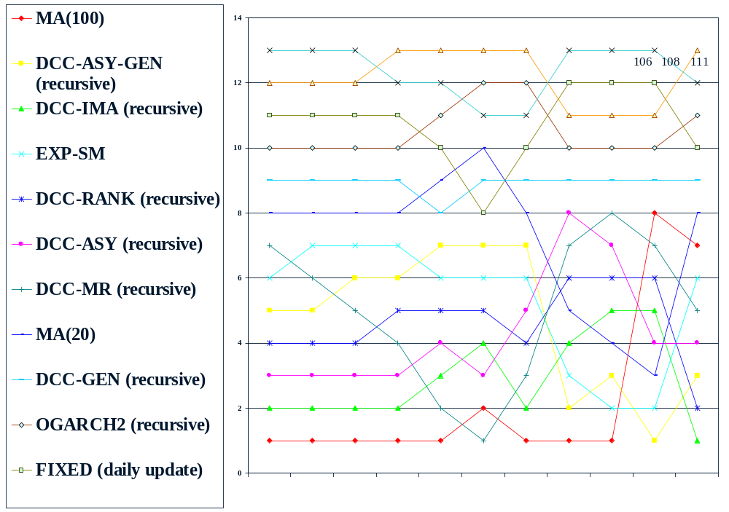
Comparision of volatilities (recursive methods)

Slide 44
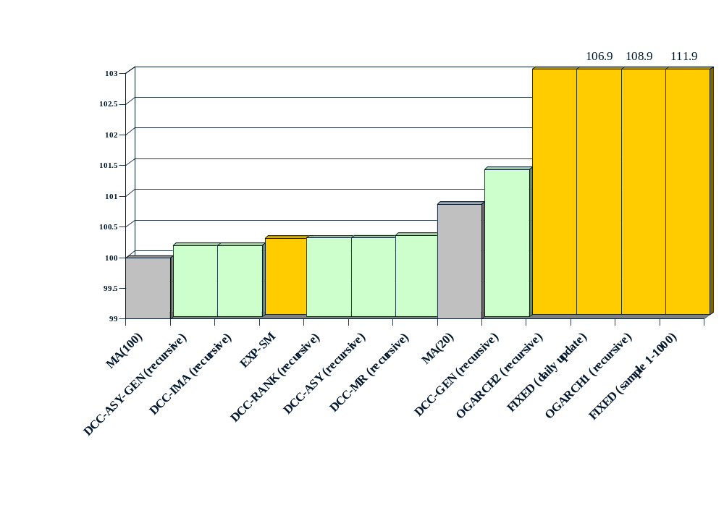
Comparision of volatilities (recursive methods)

Slide 45
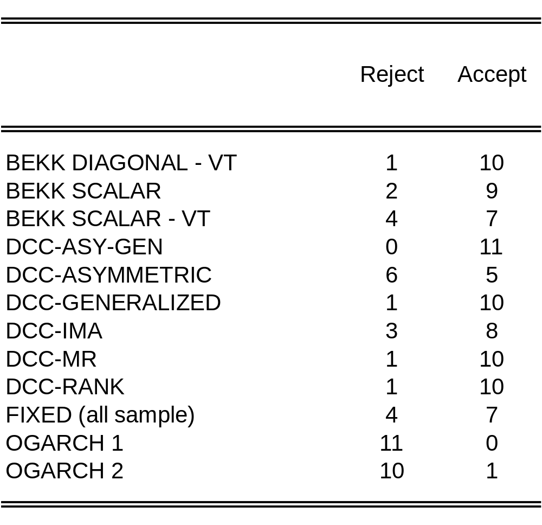
Table 161: regression with intercept, dummies and one lag: test that all the regressors are zero (level of significance is 5%)

Slide 46
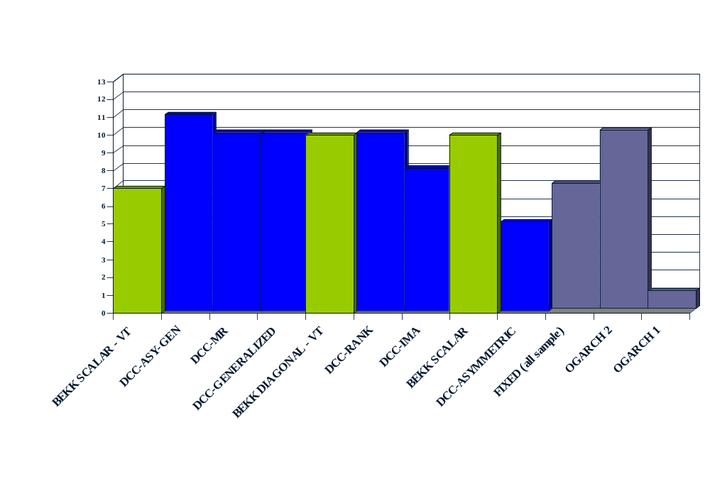
Tests of Accuracy: Number of µ’s getting 5% Acceptances

Slide 47
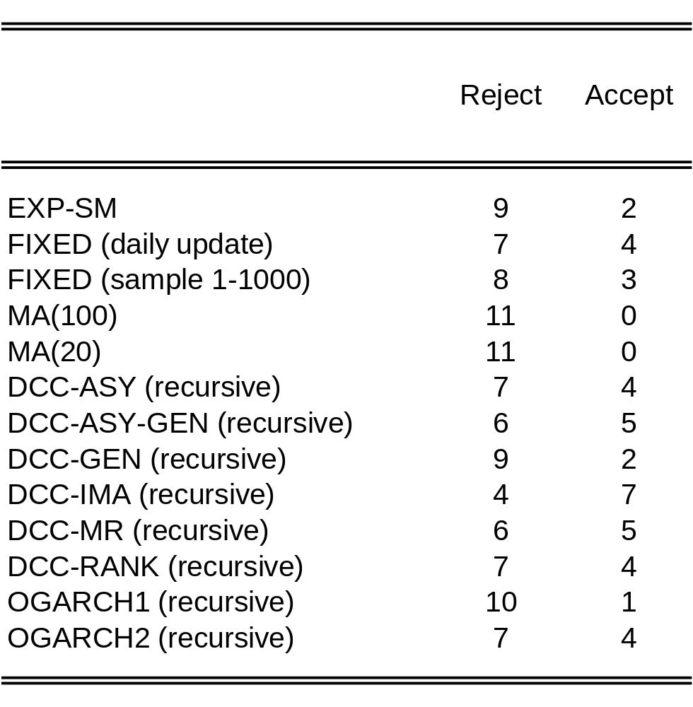
Table 162: regression with intercept, dummies and one lag: test that all the regressors are zero (level of significance is 5%)

Slide 48
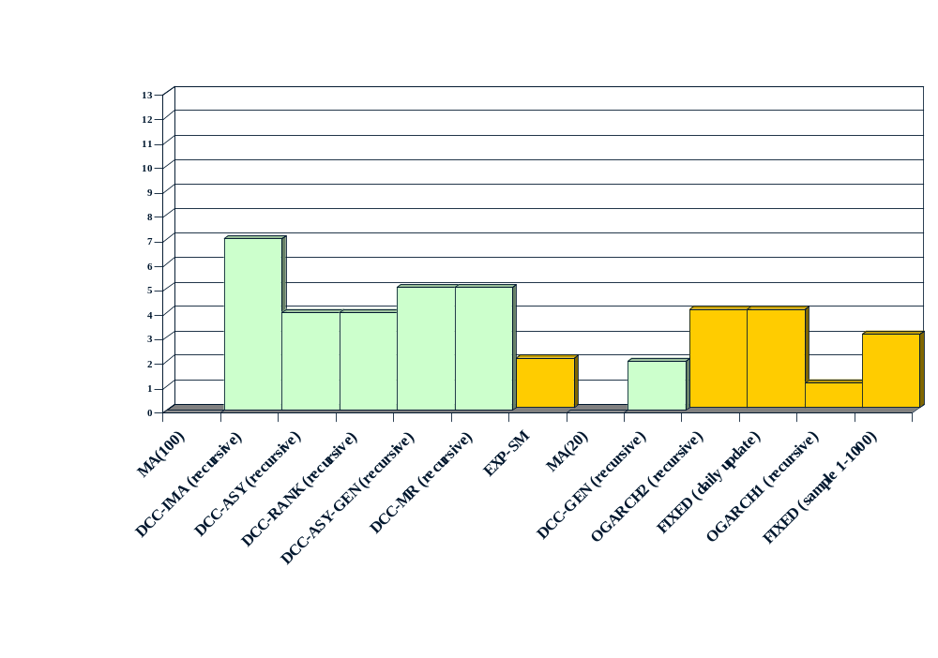
Tests of Accuracy: Number of µ’s getting 5% Acceptances

Slide 49
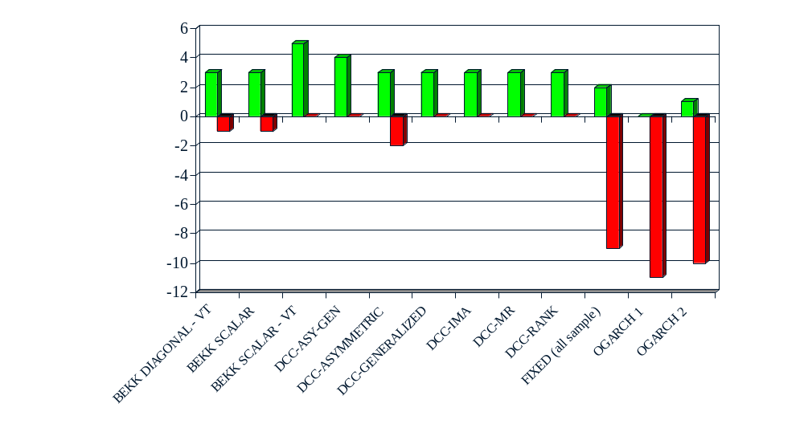
Diebold and Mariano test (variance correction)

Slide 50
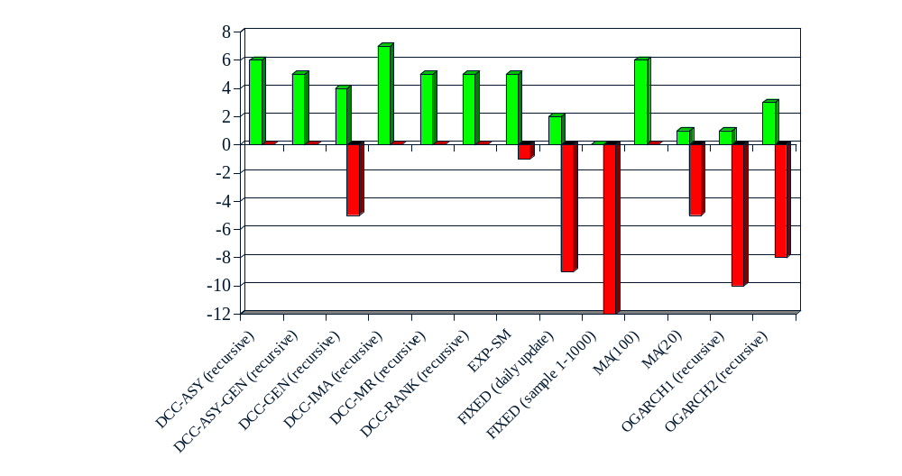
Diebold and Mariano test (no variance correction)
Recursive estimates

Slide 51
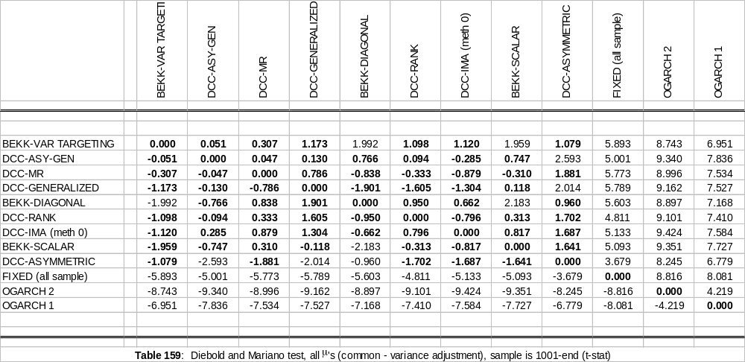
BOLD DIFFERENCES NOT SIGNIFICANT AT 5%

Slide 52
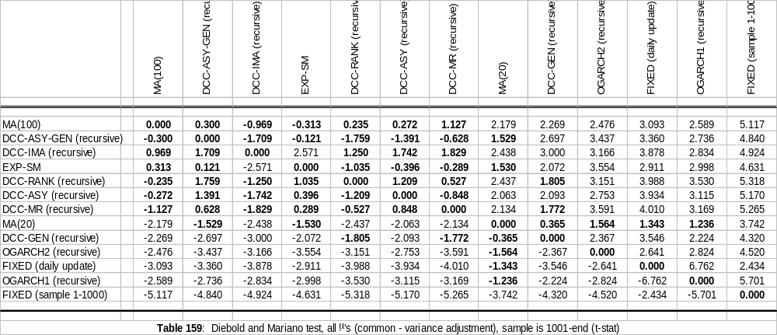
BOLD DIFFERENCES NOT SIGNIFICANT AT 5%

Slide 53
CONCLUSIONS
The Dynamic Conditional Correlation and Multivariate GARCH estimators are generally the best in this comparison.
However there is little difference between the performance of these top estimators either statistically or economically
Asymmetric correlations are often one of the best estimators but these differences are not significant.
There are differences between estimators depending on the expected return vector.
These bivariate results may not reflect the performance of bigger systems.

